Slide 1

Heart Disease Predication
Manekunta Ramesh kumar

Slide 2
About me
Name :- Manekunta Ramesh Kumar
Batch :- Ai Elite-16
Qualification :- B.tech(Mechanical)
Why Data Science:
With a mechanical Engineering in statistics, moving into data science opens up a world of professional opportunities. You may use your solid statistical education to solve challenging real-world issues. Data science offers a great way to maximize your skills and make meaningful contributions in the data-driven world because of its high demand, multidisciplinary appeal, and chances for lifelong learning.

Slide 3
Machine Learning Project Description
Titles | Description
Project Title | Heart Disease Prediction
Project Domain | Medical Analysis
Type of Machine Learning | Supervised Machine Learning
Type of Problem | Classification Problem
Project Methodology | CRISP ML-Q Methodology
Project Deployment | Streamlit
Heart Disease

Slide 4
Workflow based on CRISP ML-Q methodology :-
Business problem understanding
Data collection and understanding
Data Preparation
Exploratory data analysis
Data cleaning
Feature Engineering
Machine leaning model building
Machine learning model evaluation
Machine learning model deployment using streamlit

Slide 5
Business Problem:
Problem statement for heart disease prediction: A heart disease prediction algorithm can help detect heart diseases early, and maintain a healthy lifestyle. A group of researchers has developed an algorithm to predict the risk of heart disease based on four factors – age, gender, cholesterol ...etc Heart disease is the leading cause of death in many countries. Patients who suffer from heart disease require quick diagnosis, early treatment and constant observations. To address their needs, many data mining approaches have been used in the past in diagnosing and predicting heart diseases. Previous research was also focused on identifying the significant contributing features to heart disease prediction, however, less importance was given to identifying the strength of these features.
Objectives:
This project is to develop a Decision tree classifier predictive model for Heart Disease prediction, Data set can be used some many medical method of patients ,data is a statistics. This model aims to accurately medical data to predict the patient heart Disease confirmed or not on the based the Data

Slide 6
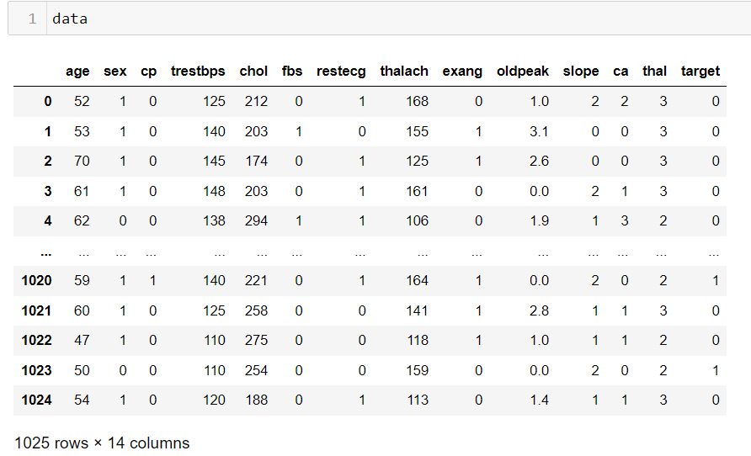
Summary Of the Data and Understanding:-
A more thorough analysis of the dataset's characteristics, including its statistical makeup and any possible ramifications for data science projects, is necessary to fully comprehend the data
Understanding of concepts like characteristics, statistical summary, possible preprocessing processes, and insights from the analysis are covered in detail in this part.

Slide 7
Dataset’s Features Description:-
I have collected data from powerful data collection source known as Kaggle ,This data set dates from 1988 and consists of four databases: Cleveland, Hungary, Switzerland, and Long Beach V. It contains 76 attributes, including the predicted attribute, but all published experiments refer to using a subset of 14 of them. The "target" field refers to the presence of heart disease in the patient. It is integer valued 0 = no disease and 1 = disease.
Features involved:-
Age
Sex (1= male, 0 = female)
cp = chest pain type
trestbps - resting blood pressure (in mm Hg on admission to the hospital) anything above 130-140 is typically cause for concern
chol-serum cholestoral in mg/dl
fasting blood sugar > 120 mg/dl(1 = true; 0 = false)
restecg - resting electrocardiographic results (values 0,1,2)
.thalach - maximum heart rate achieved

Slide 8
9.exang- exercise induced angina(1 = yes; 0 = no)
10.oldpeak = ST depression induced by exercise relative to rest
11.slope = the slope of the peak exercise ST segment
ca = number of major vessels (0-3) colored by flourosopy
.thal:thalium stress result
.target = have disease or not(1 = yes/0 = no)

Slide 9
Data Preparation :-
Exploratory data analysis:-
S No | Type | Feature Names | Observation
1 | Missing Values | NAN | The dataset is prefect ,threr is no missing values
2 | Duplicates | NA | The dataset reveals no instances of duplicates records. Its reliability for analytical purpose.
3 | Outliers | All features | It has been identified, Outliers is not exist in each feature.
4 | Distributions | hvPlot used for target and other columns | This hvplot help me to identify Number of Heart Disease of the data set to based up on the each columns To be identification
5 | Distributions | Count plot used for Disease of the patience | Analysis on status of the patience according to his target
6 | Relationships | Between input and input features | Scatter Plot reveals that the relation ship between the input features and input are dependent.

Slide 10
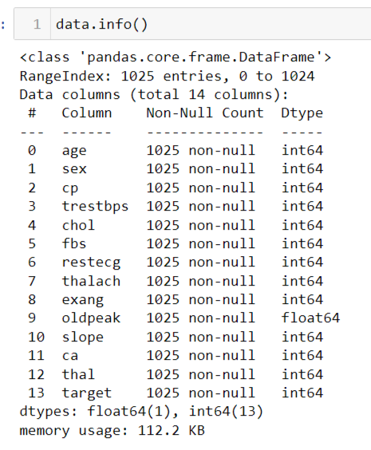
b) Data Cleaning:
Data cleaning involves crucial steps for better analysis and accurately performing machine learning model. Data cleaning contains missing values treatment, outliers treatment, duplicates record treatment , normalization, scaling, encoding etc. In this case, I found some treatment that should be done, I have performed encoding for the result column(target variables) and the missing values columns are unwanted columns of the usage so we remove the columns and we did Type casting for Date column.
c) Feature Engineering:
I have performed different feature engineering techniques such as variance score, variance threshold so it reveals there is all feature are important for prediction excepts one .There was only one feature that is not useful for analysis, I dropped that feature 'Unnamed: 0‘, and merge the Data according to the input variables and we select specific columns for the model building.

Slide 11
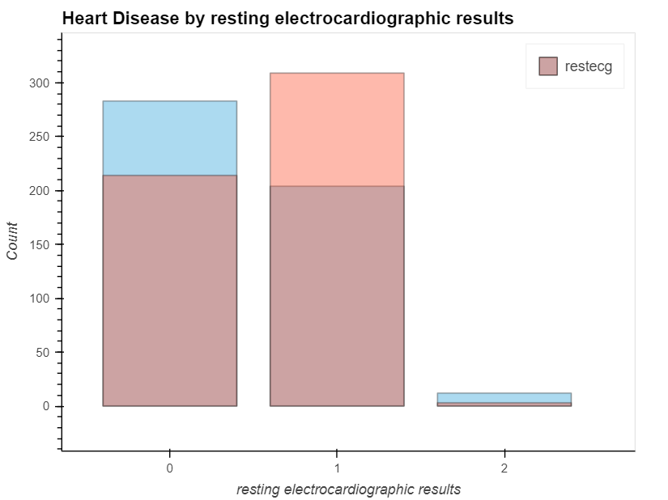
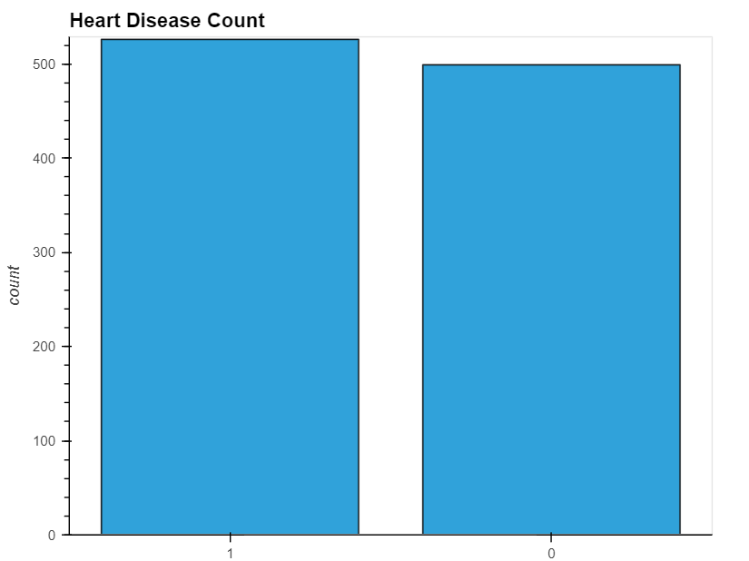
d)Data Visualization:
HoloViews Allows Plotting :-

Slide 12
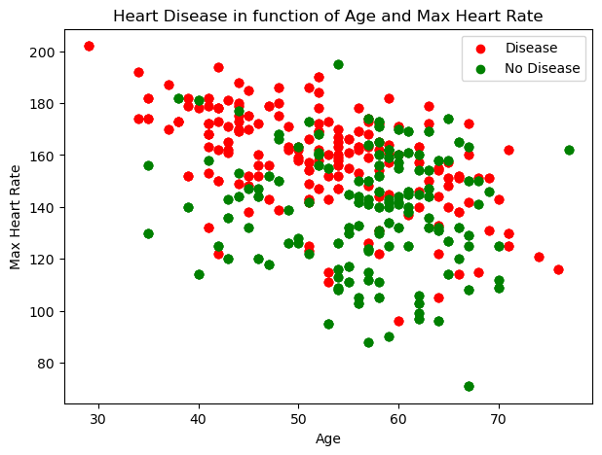
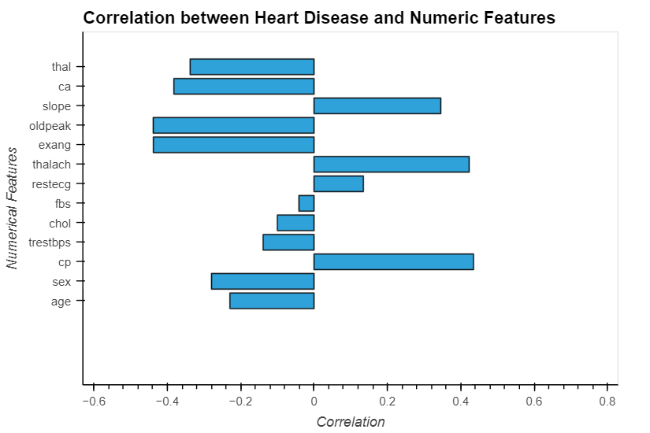
Scatter Plot :-
Hvplot:-

Slide 13
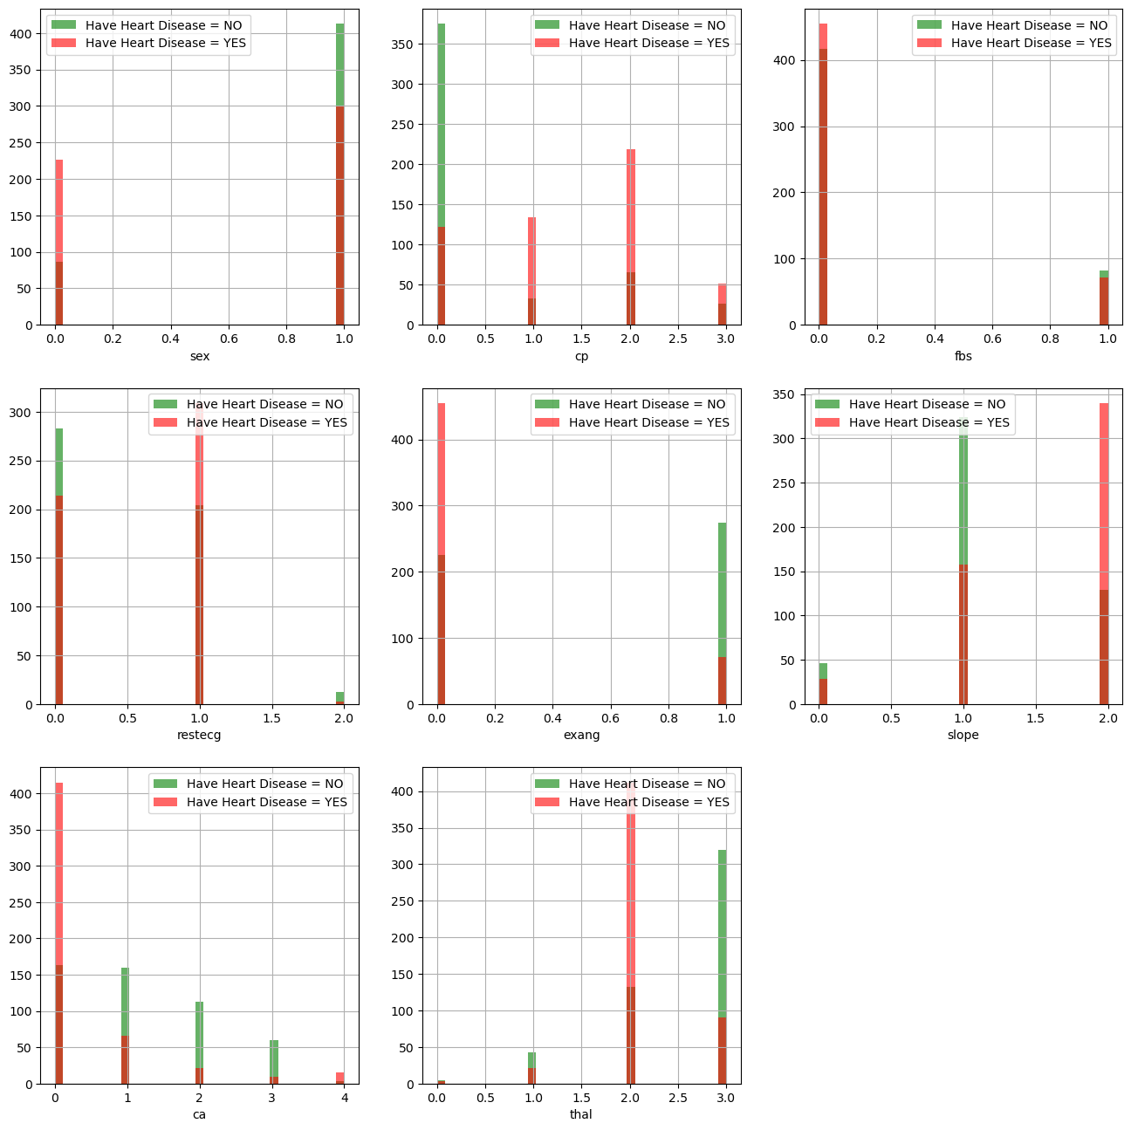
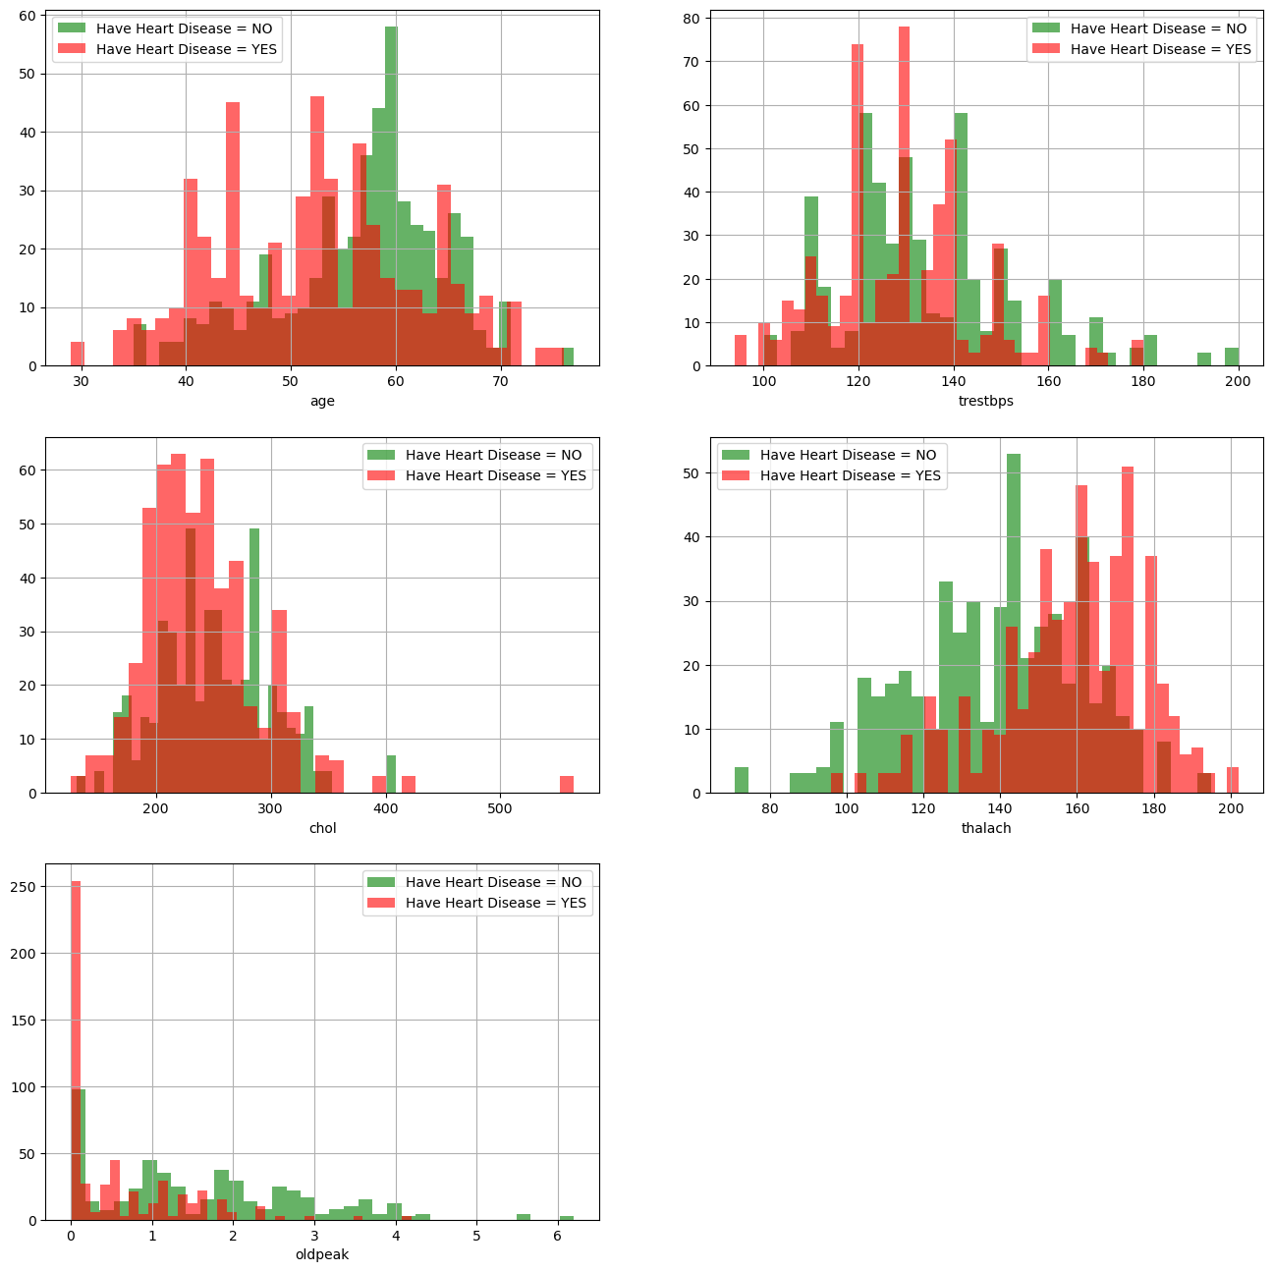
categorical_features VS Target
Numrical_features VS Target

Slide 14
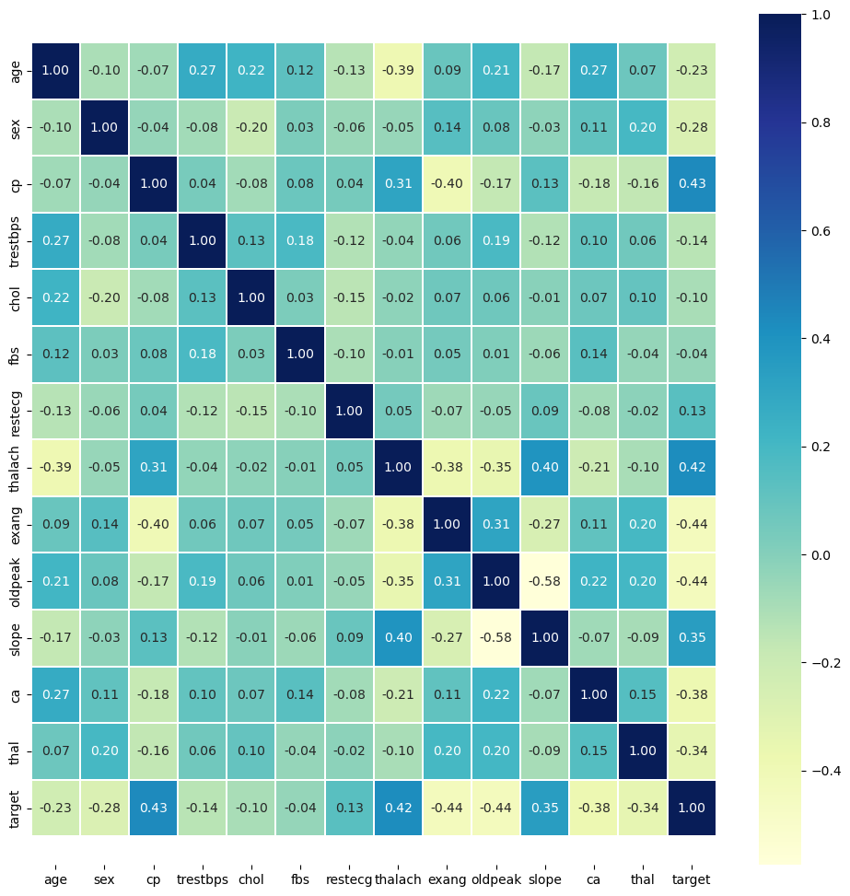
Correlation matrix

Slide 15
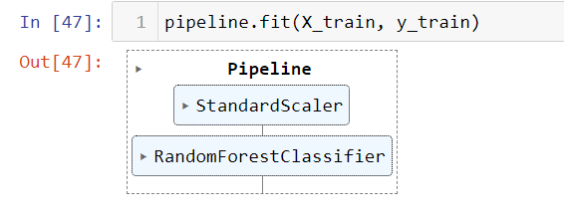
Machine Learning Model Building:-
Selection of machine learning algorithm is crucial and confusing task, based on my problem statement my data was normally distributed and target is categorical variable, so I have used Random Forest, also I developed pipeline and in that pipeline and based on their performance.
I split the data into x as inputs and y as Output and then split inputs and output into train and test after splitting looks as x_train , x_test , y_train , y_test. Because splitting the data is important thing to build machine learning model.
After splitting I trained my model using x_train and y_train.

Slide 16
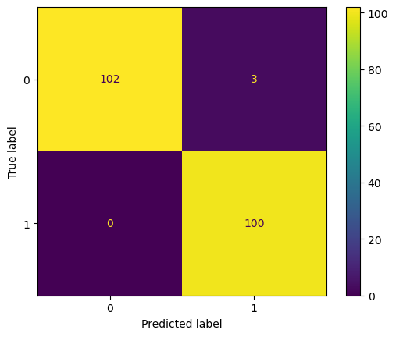
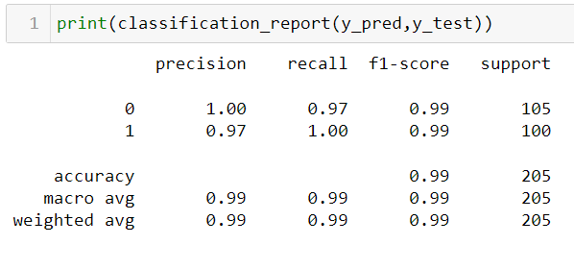
Machine Learning Model Evaluation:-
In machine learning model evaluation, I used different evaluation matrix such as Accuracy score, F-1 score, Confusion matrix. Accuracy shows how often model is predicting accurately and Confusion matrix shows how much it predicted correctly as well as incorrectly.
We can see in image Decision Tree Classifier is best performer as per accuracy score.
Confusion Matrix:-

Slide 17
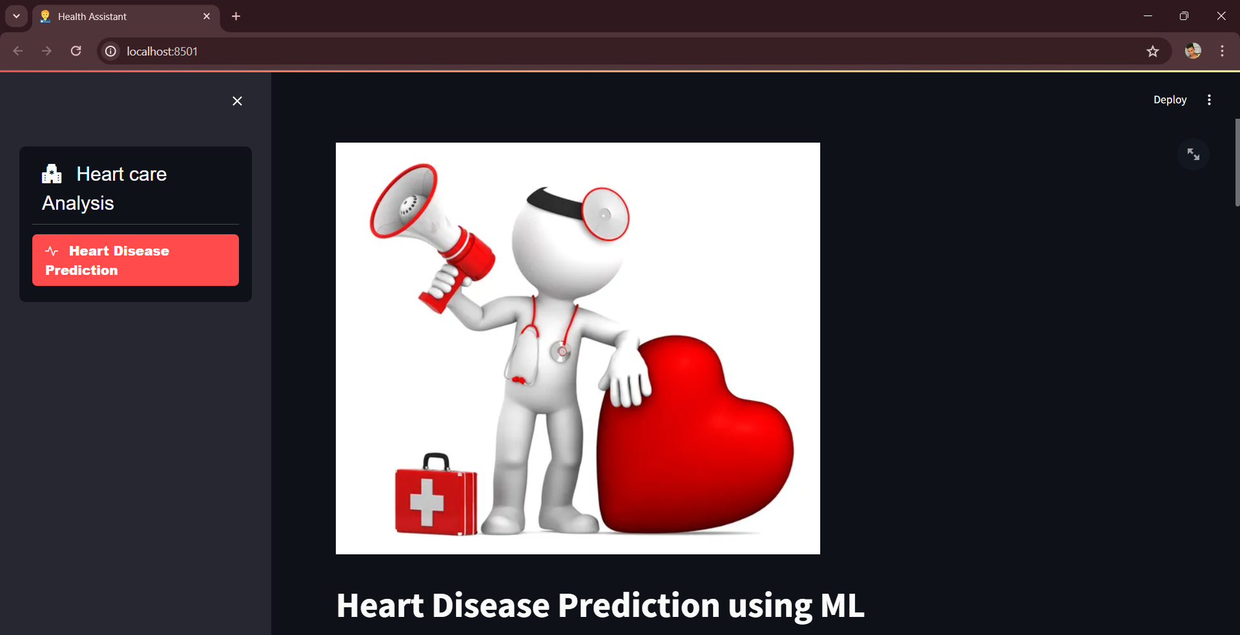
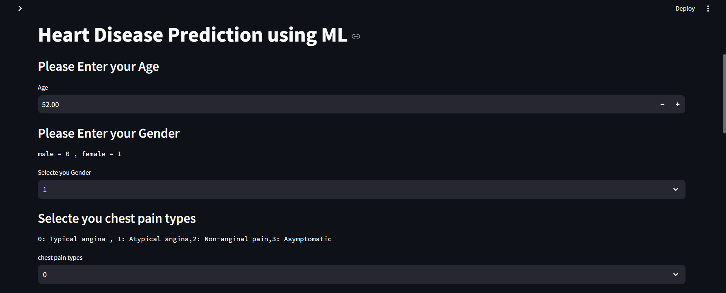
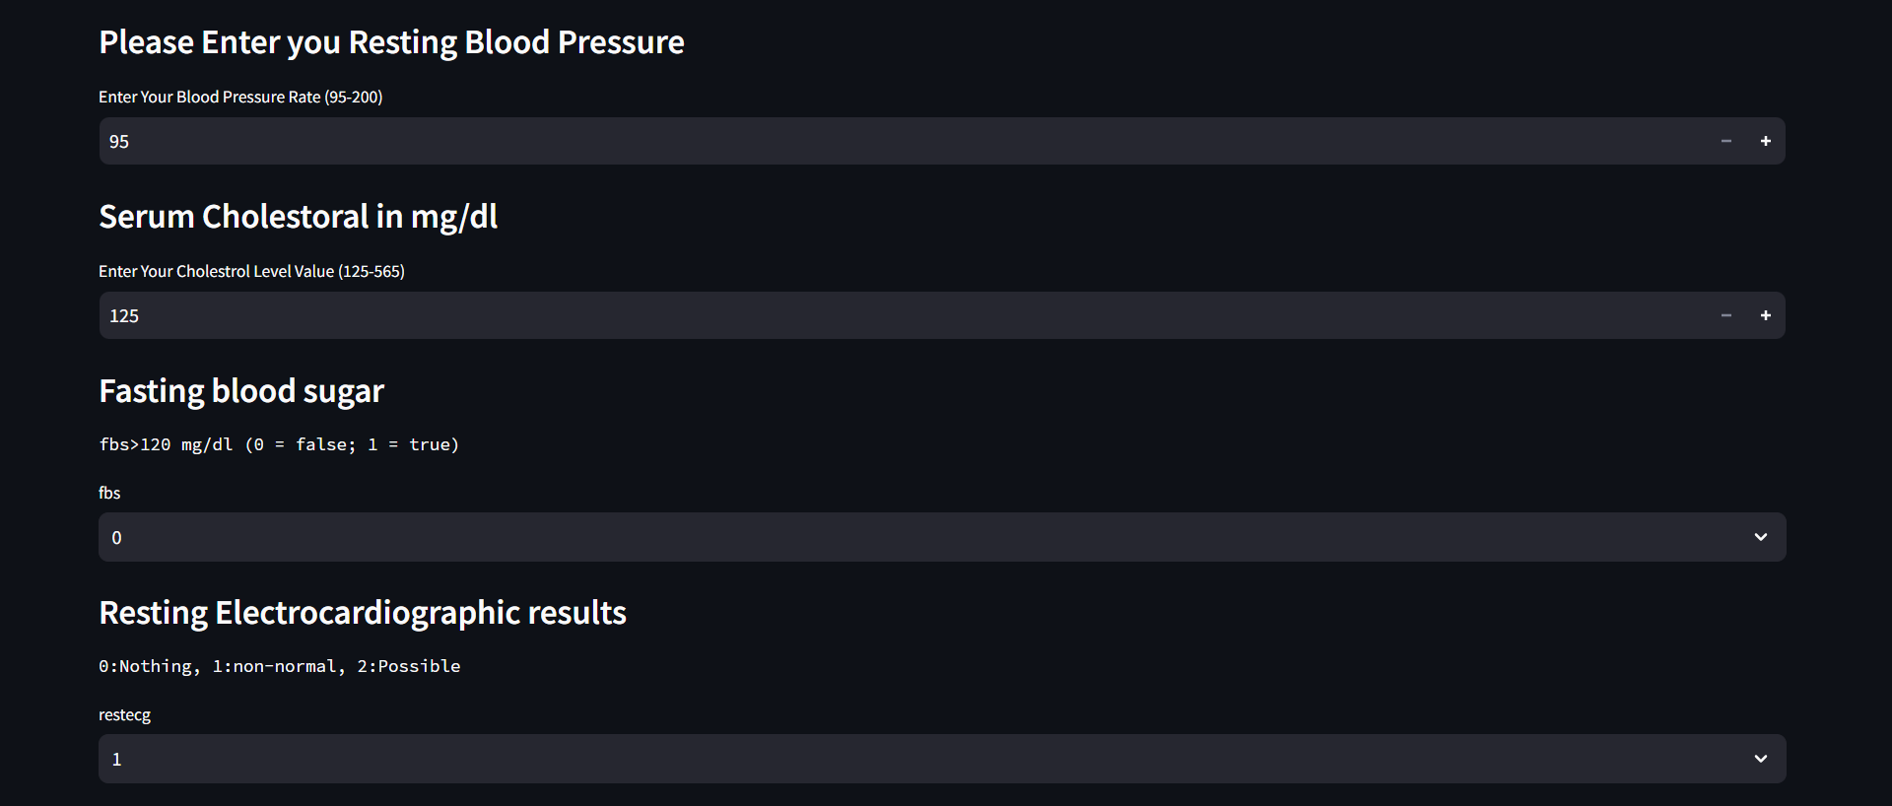
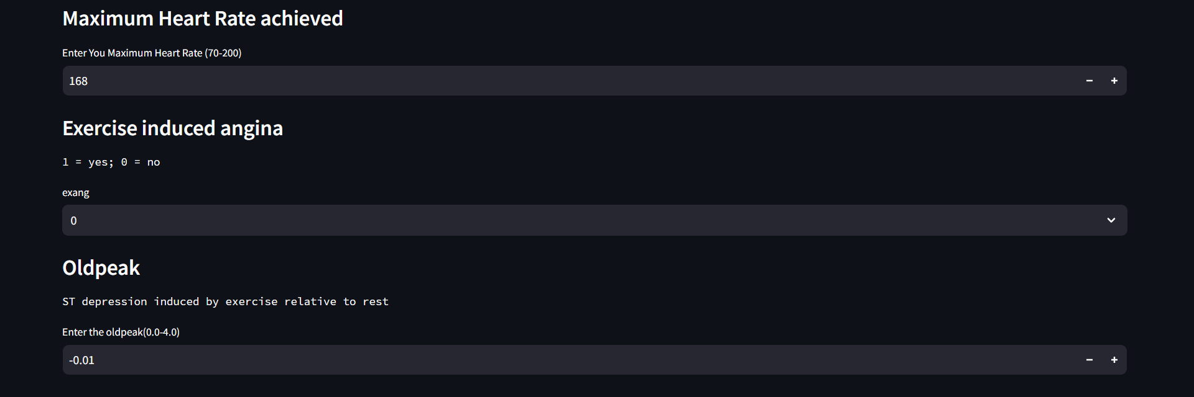
Machine Learning Model Deployment:

Slide 18
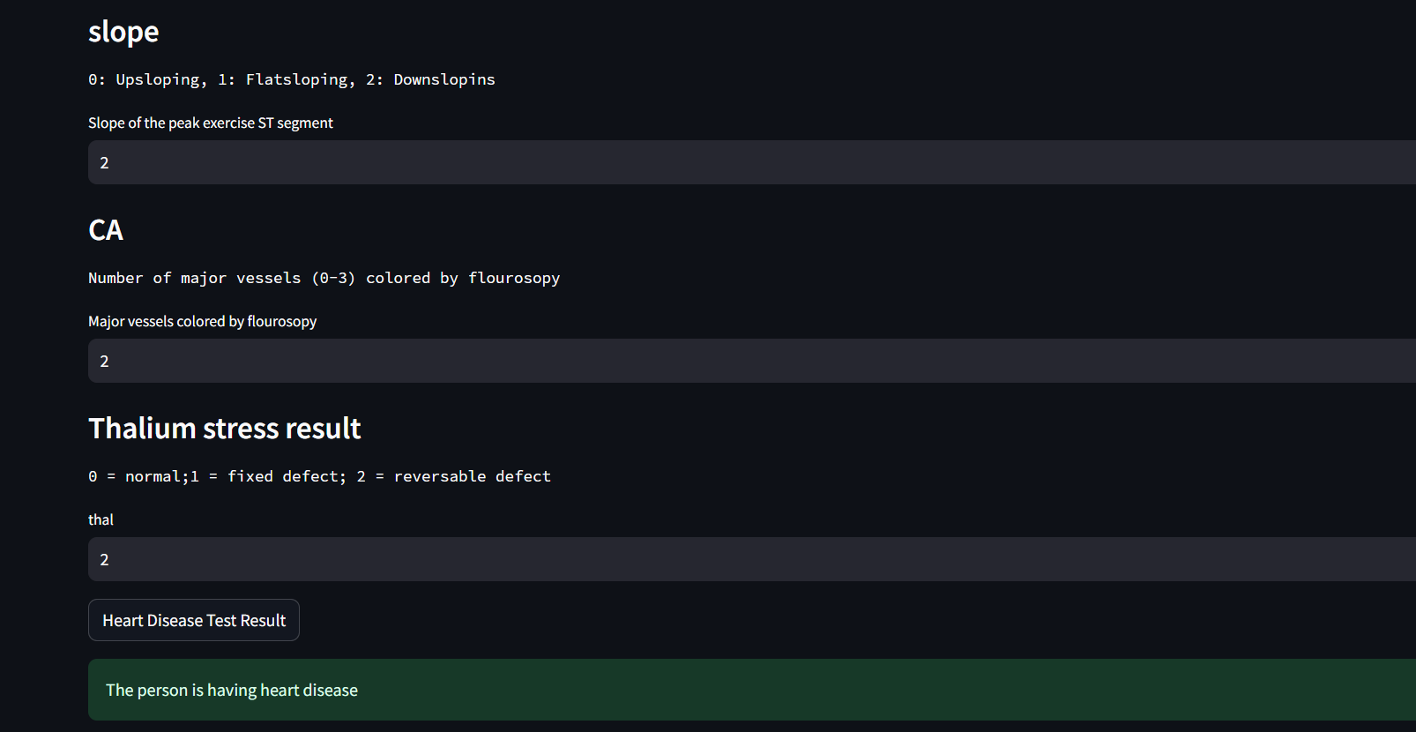

Slide 19
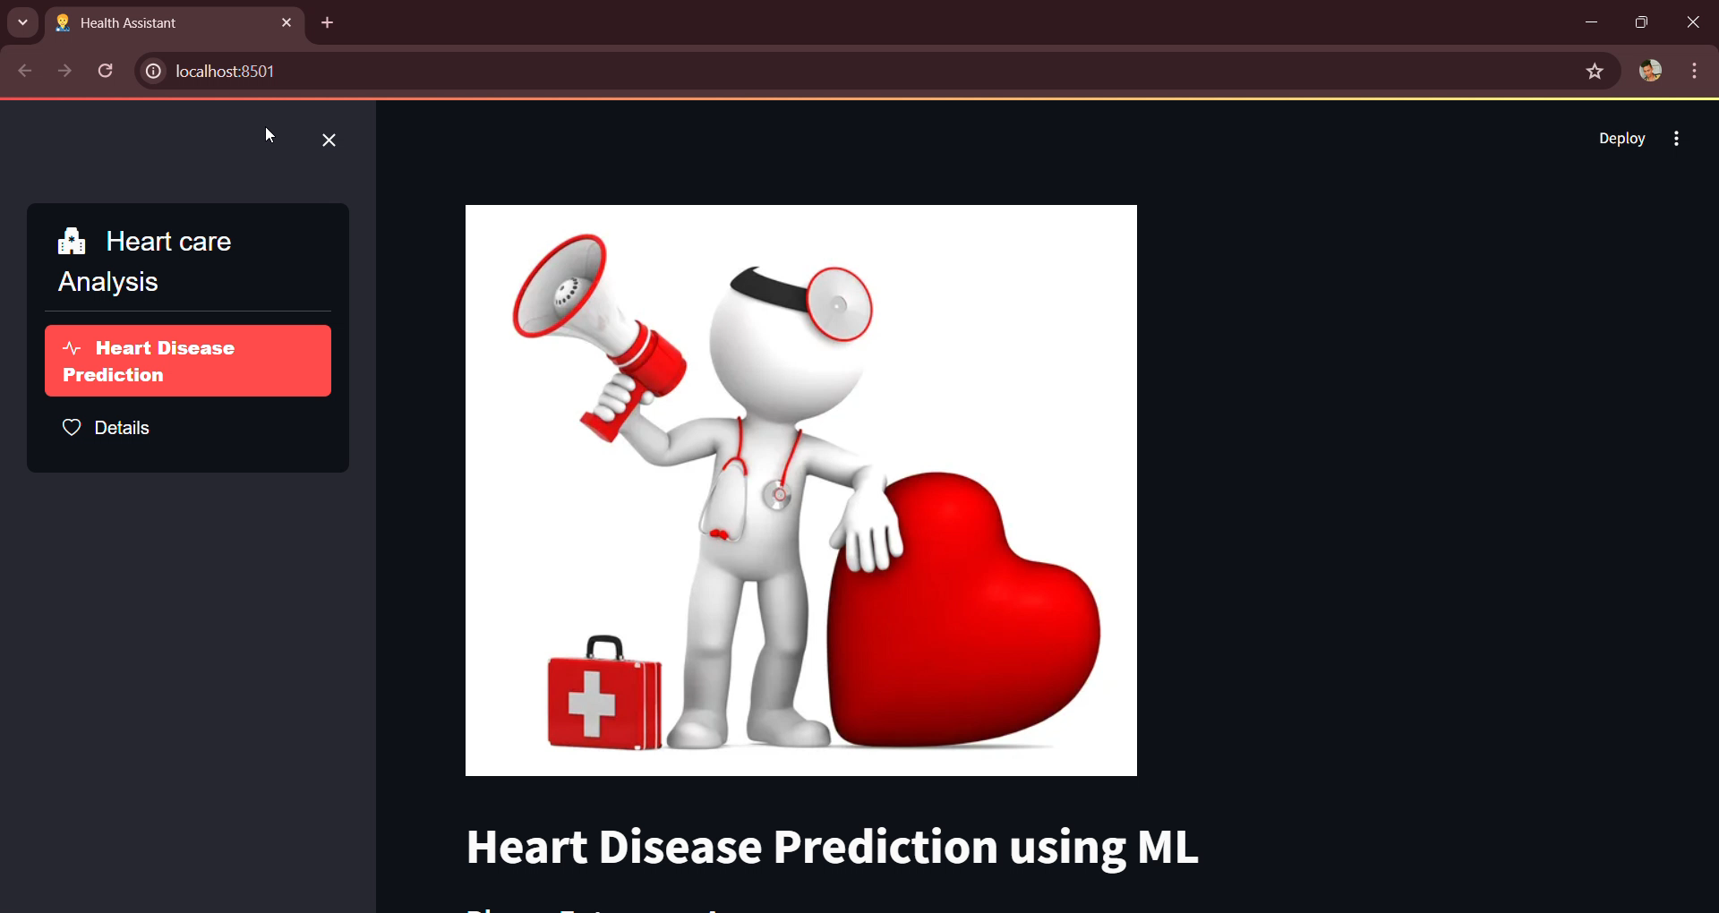
Website : -

Slide 20
Application of Personality Prediction Web Application:-
This web application can be used to identify the Heart disease based on the Probability of the model.
This web application can be used to analyze (or) predicted the Disease of the patient
Conclusion:-
In conclusion, journey through the analysis and model development of personality dataset with decision tree has been insightful and productive. I understand the problem statements, and I collect the data and understand that data to perform better analysis and prepare the data perform necessary data cleaning steps.
The dataset has been used in various studies to predict the presence of coronary heart disease with high accuracy, with some models achieving up to 98% accuracy.
The heart disease dataset is a valuable resource for researchers and clinicians seeking to develop and evaluate machine learning models for predicting the presence of coronary heart disease. The dataset has been used in various studies to achieve high accuracy and has the potential to improve the diagnosis and treatment of heart

Slide 21


